Slide 1
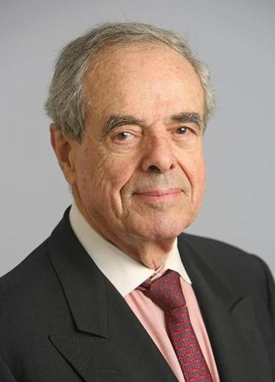
Managers
Leaders
&
Abraham Zaleznik
Are they different?
Andres G. & Jorge F.
Notes:
This Article was written by abraham zaleznik in 2004. He was a profesor emeritus at the harvard business school.

Slide 2
Characteristics
Outline
Development
Notes:
In this presentation, we are going to talking about personality of manager and leaders and how this can be develop

Slide 3
Personality
Managers
Leaders
Attitudes towards goals
Conceptions of work
Relations with others
Sense of self

Slide 4
Personality
Managers
Leaders
Attitudes towards goals
Take an impersonal, passive outlook.
Goals arise out of necessities
Take a personal, active outlook
Change how people think about what's desirable and possible.
Set company direction.

Slide 5
Personality
Managers
Leaders
Conceptions of work
Negotiate and coerce. Balance opposing views.
Design compromises. Limit choices.
Avoid risk.
Develop fresh appraches to
Problems.
Increase options. Turn ideas into exciting images.
Seek risk when opportunities appear promising.

Slide 6
Personality
Managers
Leaders
Relations with others
Prefer working with people. But maintain minimal emotional involvement.
Focus on process
Relate to others directly , intuitively, empathetically.
Focus on events and decisions, including their meaning for participants

Slide 7
Personality
Managers
Leaders
Sense of self
Comes from perpetuating and strengthening existing institutions.
Feel part of the organization.
Comes from struggles to profoundly alter human and economic relationships
Feel separate from the orgaization

Slide 8
Development
of leaders in organizations
Avoid overreliance on peer-learning situations. They stifle the aggressiveness and initiative that fuel leadership.
Cultivate one to one relationships between mentors and apprentices. Close working relationships encourage intense emotional interchange and tolerance of competitive impulse.

